Slide 1

HOW TO WRITE A “DECENT” COMPOSITION

Slide 2
What are the basics?
Title
Introduction
Body (development)
Conclusion

Slide 3
INTRODUCTION.
Tell them what you are going to tell them.
BODY
Tell them.
CONCLUSION
Tell them what you told them

Slide 4
Organize and separate your ideas…

Slide 5


Slide 6


Slide 7
So, teacher, what do you mean by “separate and organize” ideas!?!?!??!

Slide 8


Slide 9
Also you must remember to use commas periods and or whatever punctuation that is necessary ok

Slide 10

?!?!

Slide 11


Slide 12


Slide 13
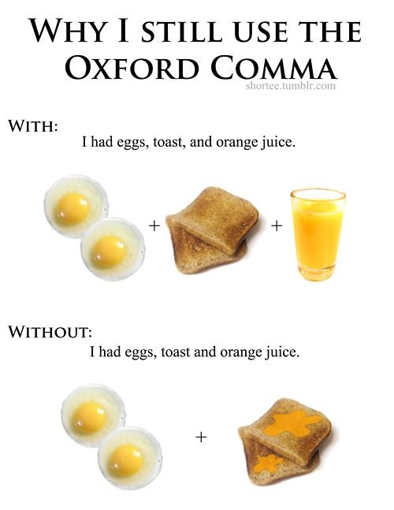

Slide 14


Slide 15
Don’t be a bore! Use synonyms ☺

Slide 16
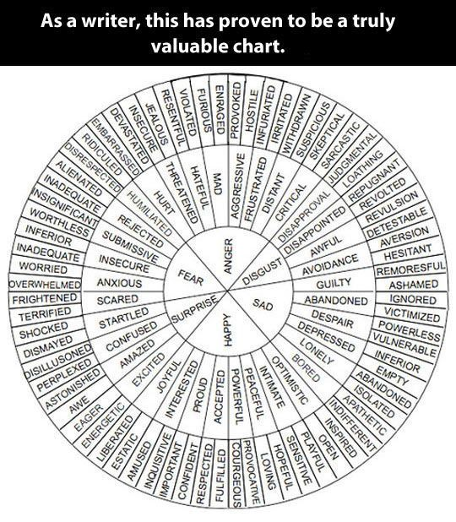

Slide 17


Slide 18
Choose the right word to link your awesome ideas ☺

Slide 19
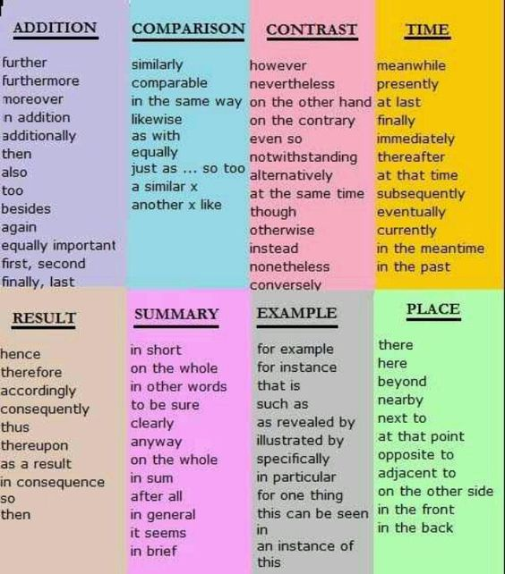

Slide 20
Don’t ever dare forget to write your name!!

Slide 21


Slide 22
Always read and re-read your writing before giving it to Ana!

Slide 23


Slide 24


Slide 25
For God’s sake, never ask Google to do the homework for you!!!

Slide 26


Slide 27


Slide 28


Slide 29
